Slide 1
Markov-chain Monte Carlo
An (almost) maths-less introduction
Lorenzo Pellis
(with the help of many others!
Thanks Sam, Simon, Samik…!)
University of Warwick, UK
WIDER, 8th March 2016

Slide 2
Outline
Introduction
The main example – coin tossing
Explaining confusing concepts
Monte Carlo methods
MCMC
MCMC in practice:
MCMC for coin tossing (1 dim)
Diagnosing your MCMC
Tricks
MCMC in 2 dim
Play with Matlab or R

Slide 3
Introduction
The main example – coin tossing
Explaining confusing concepts
Monte Carlo methods
MCMC

Slide 4
Example – coin tosses
You toss a coin times. You get:
H H T H H T H H H H
Arbitrarily, call H a success (1) and T a failure (0):
1 1 0 1 1 0 1 1 1 1
The number of heads is:
Questions:
is the coin is fair?
how confident are you in your answer?
and what if you had 79 head out of 100 tosses?
Key point:
Estimating a single number is usually not enough information!

Slide 5
Binomial distribution
If we believe that:
all tosses are independent of each other
output can only be head or tail (and nothing else)
head occurs with the same probability each time
Then the probability of getting heads out of trials, each with success probability is:
Key point: we are assuming a model (often without realising)
binomial coefficient

Slide 6
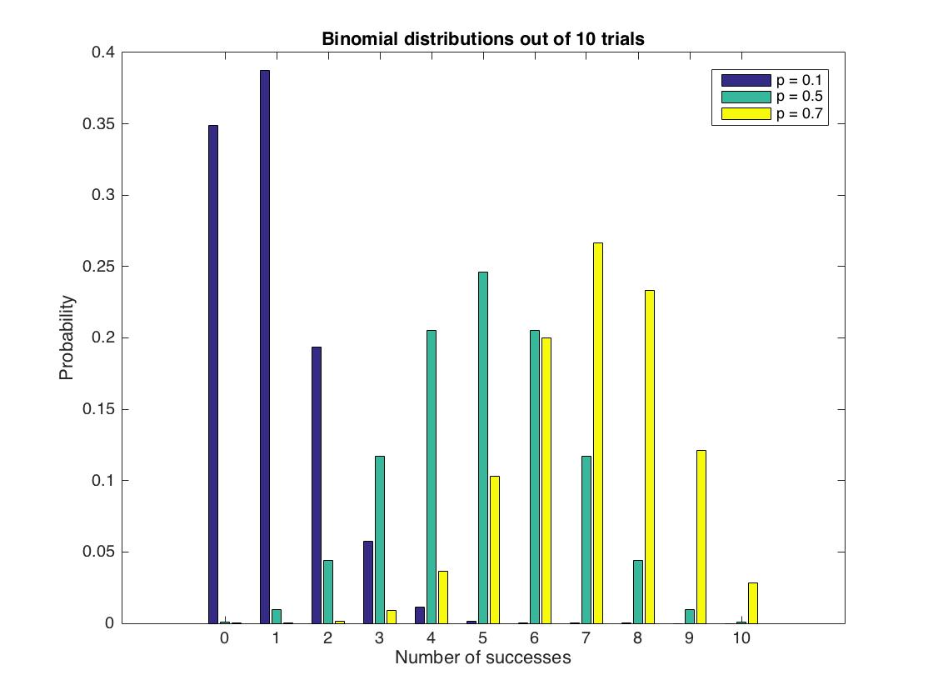
Binomial distribution
If we would expect 8 heads out of 10 tosses only 5% of the time

Slide 7
Likelihood function
For parameters and data , the likelihood function is defined as:
Numerically same as the probability, but different interpretation.
In ,
is thought as fixed, varies; and
In ,
is thought as fixed, varies; and
in general

Slide 8
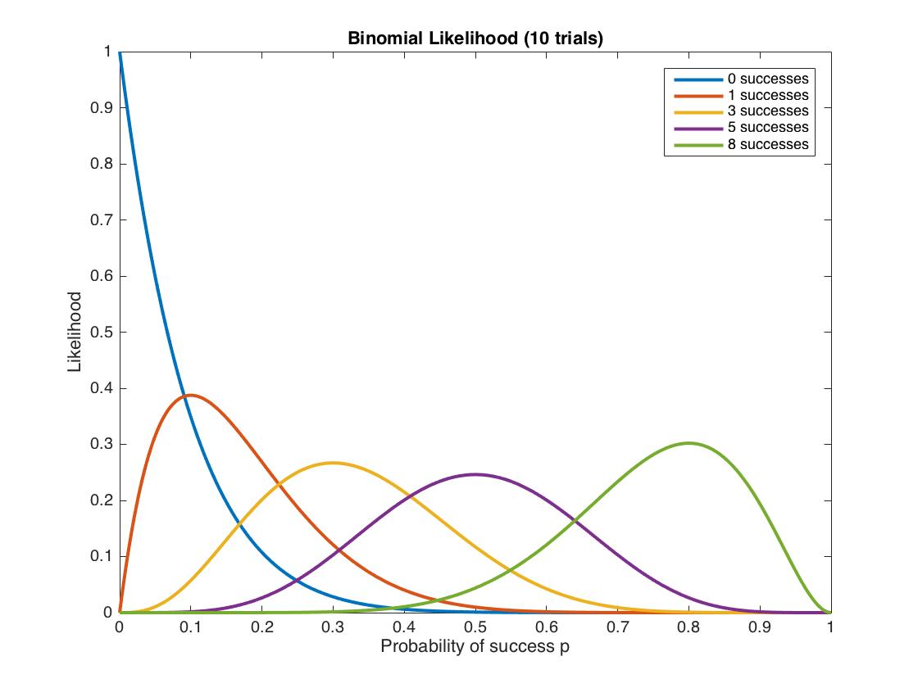
Binomial likelihood

Slide 9
Introduction
The main example – coin tossing
Explaining confusing concepts
Monte Carlo methods
MCMC

Slide 10
Classical VS Bayesian
This is mostly a philosophical question, but in summary:
Frequentist (classical) perspective:
a parameter has a true exact value, which we don’t know
Bayesian perspective:
a parameter is a random variable, which we can describe using its distribution function

Slide 11
Classical statistics
The goal is to study the likelihood

Slide 12
Maximum likelihood estimator (MLE)
Given there is only 1 true value of the parameter (classical stats), the interest is in finding the maximum likelihood (ML) estimate:
the parameter value at which the likelihood is maximal
This can be found analytically or using numerical methods that “climb” up the hill

Slide 13
Confidence interval
How confident I am in my ML estimate?
I can draw confidence intervals (CI)
assuming asymptotic normality
Note that
The parameter is fixed
The MLE is a random variable
The CI is an interval centred in the MLE
a 95% CI is a random interval that covers the true value 95% of the times
True value
MLE
MLE

Slide 14
Bayesian statistics
The likelihood is still key, but the goal now is to study the posterior

Slide 15
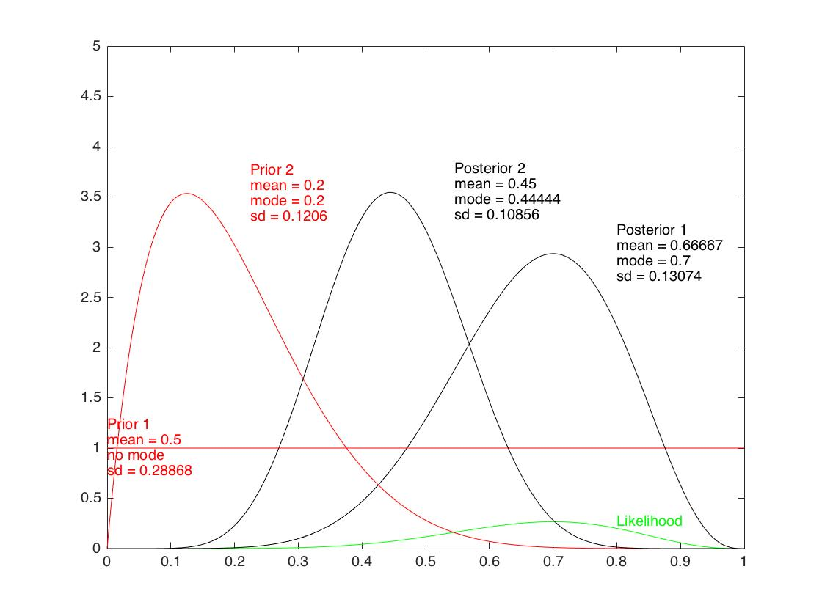
Bayes’ theorem
Likelihood (which contains the data)
Prior
Posterior
Normalising constant, difficult to compute

Slide 16
Introduction
The main example – coin tossing
Explaining confusing concepts
Monte Carlo methods
MCMC

Slide 17
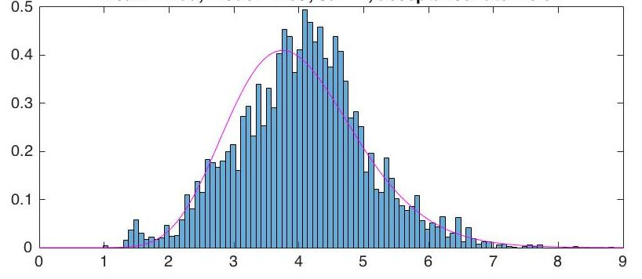
Exploring the posterior
I am now not interested only in the maximum, I want the full distribution
Two options:
Analytically, which can be done sometimes (e.g. conjugate priors)
using Monte Carlo methods, i.e. “approximating it with a histogram”

Slide 18
Monte Carlo methods
Monte Carlo means “by generating random numbers”
By generating lots of random numbers from a distribution I can
explore it
compute functions of the random variable with that distribution
I might even explore a distribution that I can’t even write, as long it is the result of a simulation (often the case in biology)
Monte Carlo methods are the only thing that works in high dimensions (often the case in practice)
Biological applications (e.g. epidemiology, phylogenetics) always have high dimensions, because you need to impute a lot of unobserved events (infections, coalescence events)

Slide 19
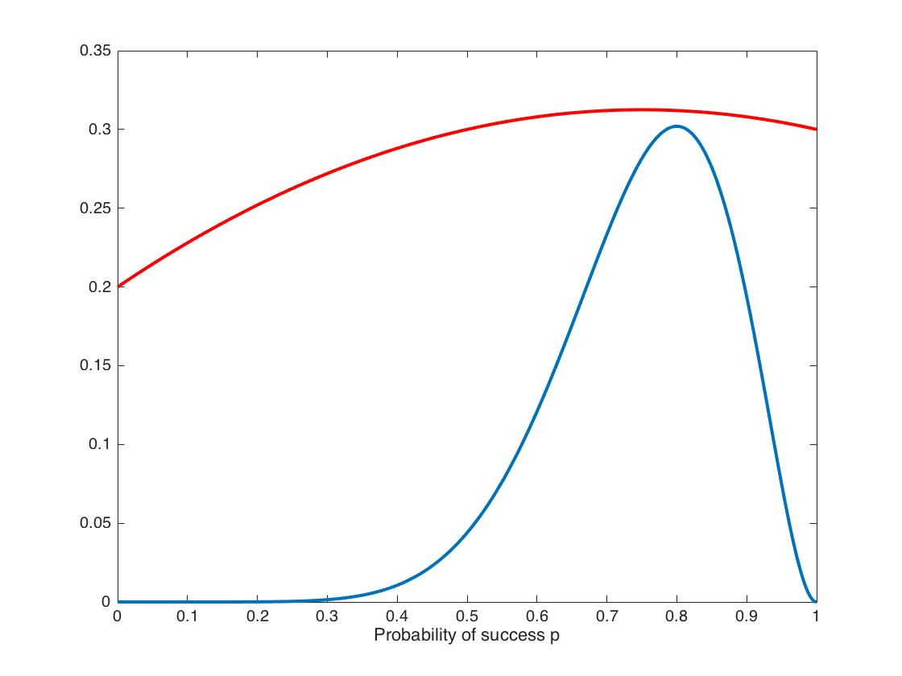
Monte Carlo Rejection Sampling
Ordinary Monte Carlo methods explore a function by generating lots of independent samples
If I can draw directly from the distribution of interest (blue line), then I simply do it
If I can’t I can use the rejection sampling method:
Sampling from another distribution I can sample from (red line) which “cover” the other distribution
accept/reject with some probability
Likely to reject
Likely to accept

Slide 20
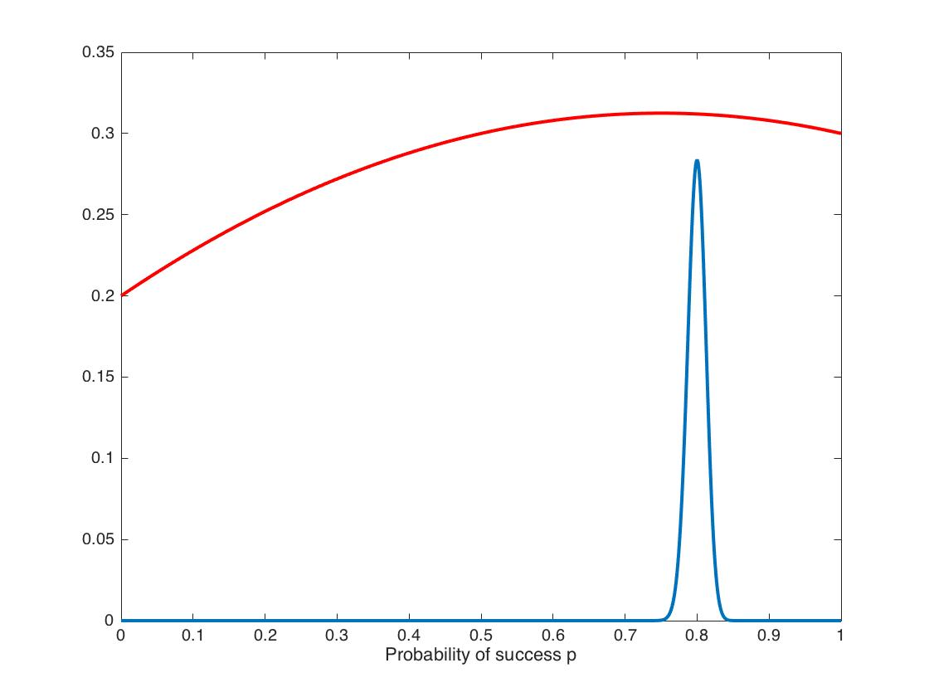
Problems with rejection sampling
Hard to find a good distribution (red line) to sample from
Hard to find how much I need to “inflate” it to “cover the other curve
Can be very inefficient
Sampling this is easy (few rejections)
Sampling this is hard (lots of rejections)
In general it is really hard to explore a distribution by independent samples in many dimensions (too many rejections – very inefficient)
MCMC is a way to explore more efficiently distributions in many dimensions

Slide 21
Introduction
The main example – coin tossing
Explaining confusing concepts
Monte Carlo methods
MCMC

Slide 22
Markov chains
A Markov chain is a stochastic process, i.e. a system that evolves in time according to a probabilistic rule, where
the time is discrete
the probabilistic rule at each step depends only on the current step (and nothing before then) – Markov property
It is described by a family of random variables
with values in a state space (discrete or continuous)
where for each , depends only on and not on
Example: snakes and ladders (it doesn’t matter how you arrived where you are; it only matter where you are and the result of rolling the die)
Under some assumptions, the chain has a stationary distribution: if you let it run long enough, no matter where you started from, you end up bouncing around this distribution

Slide 23
Markov chain Monte Carlo
Goal: we need to explore the posterior distribution
It might be difficult to sample from it, but it is surprisingly easy to construct a Markov chain that has as stationary distribution the posterior distribution. So,
run the Markov chain for long enough, until it has “converged”
from that moment onwards I am sampling from the posterior
Pluses: I explore the posterior efficiently, even in high dimensions (because I stay in the regions of high probability, if already there)
Minuses: I am not drawing independent samples anymore:
I need more samples to have the same “exploratory power”
I don’t know many “more samples” are enough
It’s a dark art: I know that if it has converged it’s giving me the right answer, but there is no principled way of telling it has converged

Slide 24
Summary: why MCMC
In a Bayesian framework, we pull together prior and likelihood (i.e. data) to obtain the posterior
We want to explore the posterior, but it’s difficult to do it analytically
This is particularly the case for many applied problems
Monte Carlo methods are ductile and can in principle work in high dimensions, but in practice are very inefficient
MCMC methods improve the efficiency, at the price of having dependent samples (rather than “more powerful” independent ones)
We need to make sure that this “dependency” is not ruining our job

Slide 25
MCMC in practice
MCMC for coin tossing (1 dim)
Diagnosing your MCMC
Tricks
MCMC in 2 dim

Slide 26
MCMC in practice
MCMC for coin tossing (1 dim)
Diagnosing your MCMC
Tricks
MCMC in 2 dim

Slide 27
MCMC structure
3 main steps:
Propose new values for the parameters
Compute the likelihood at the new values
Decide whether to:
accept: move to the new values
or reject: stay where you are and count again the current values
and these three steps are repeated many times!
The most expensive step is typically the computation of the likelihood

Slide 28
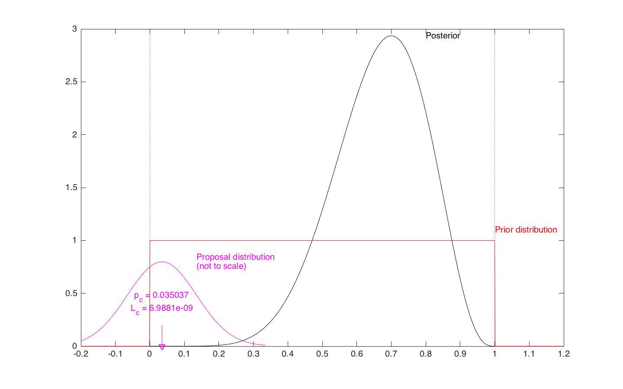
MCMC

Slide 29
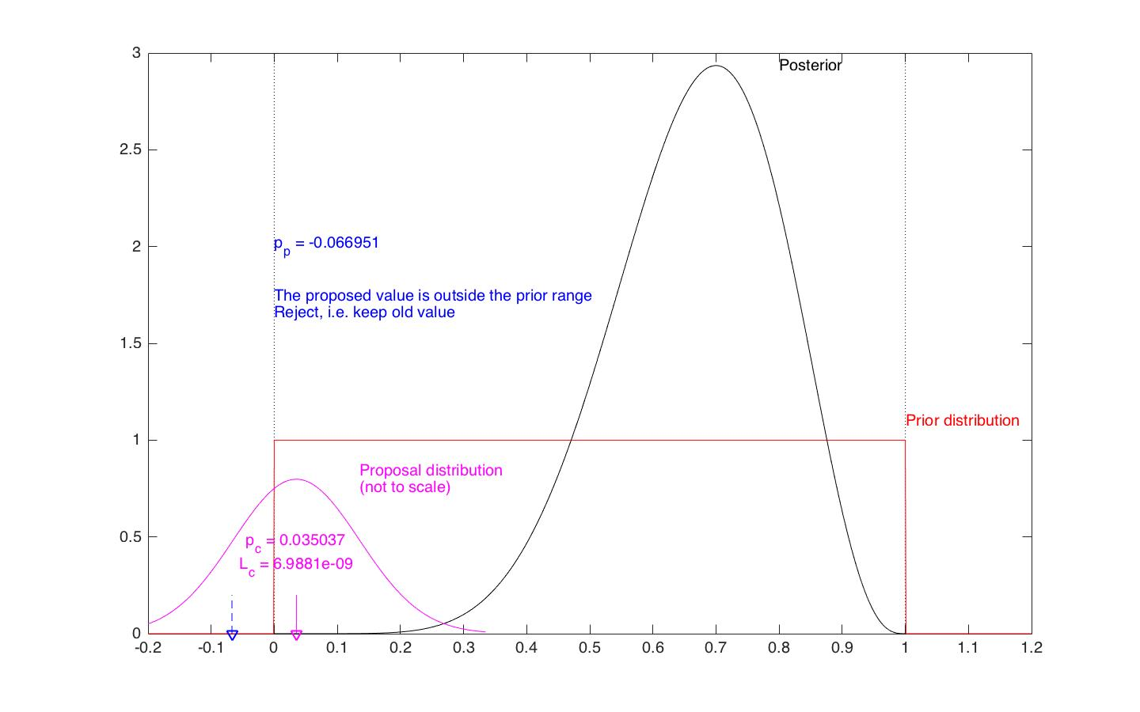

Slide 30
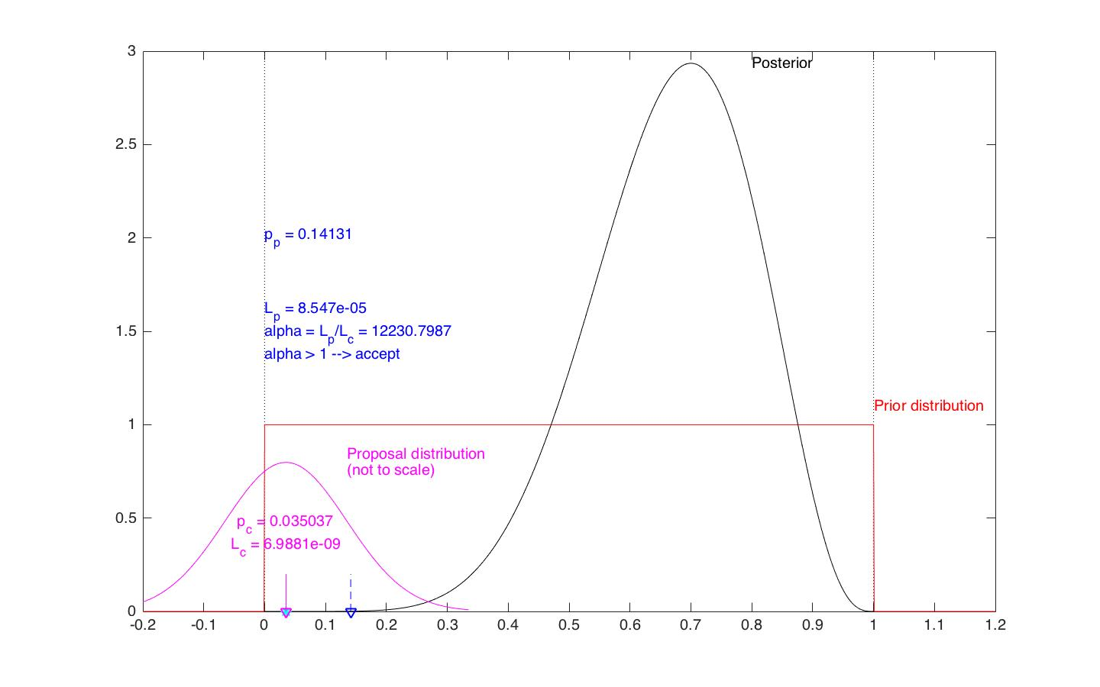

Slide 31
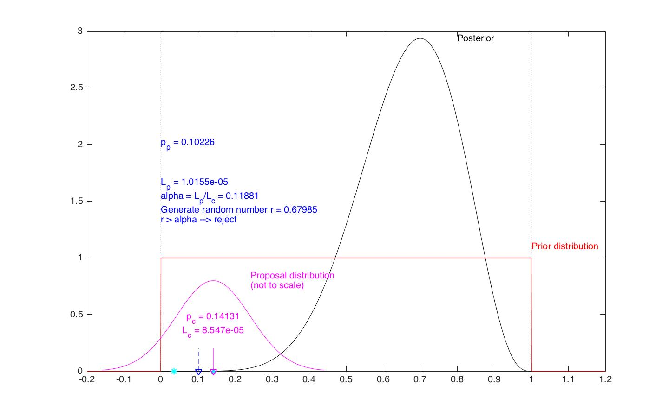

Slide 32
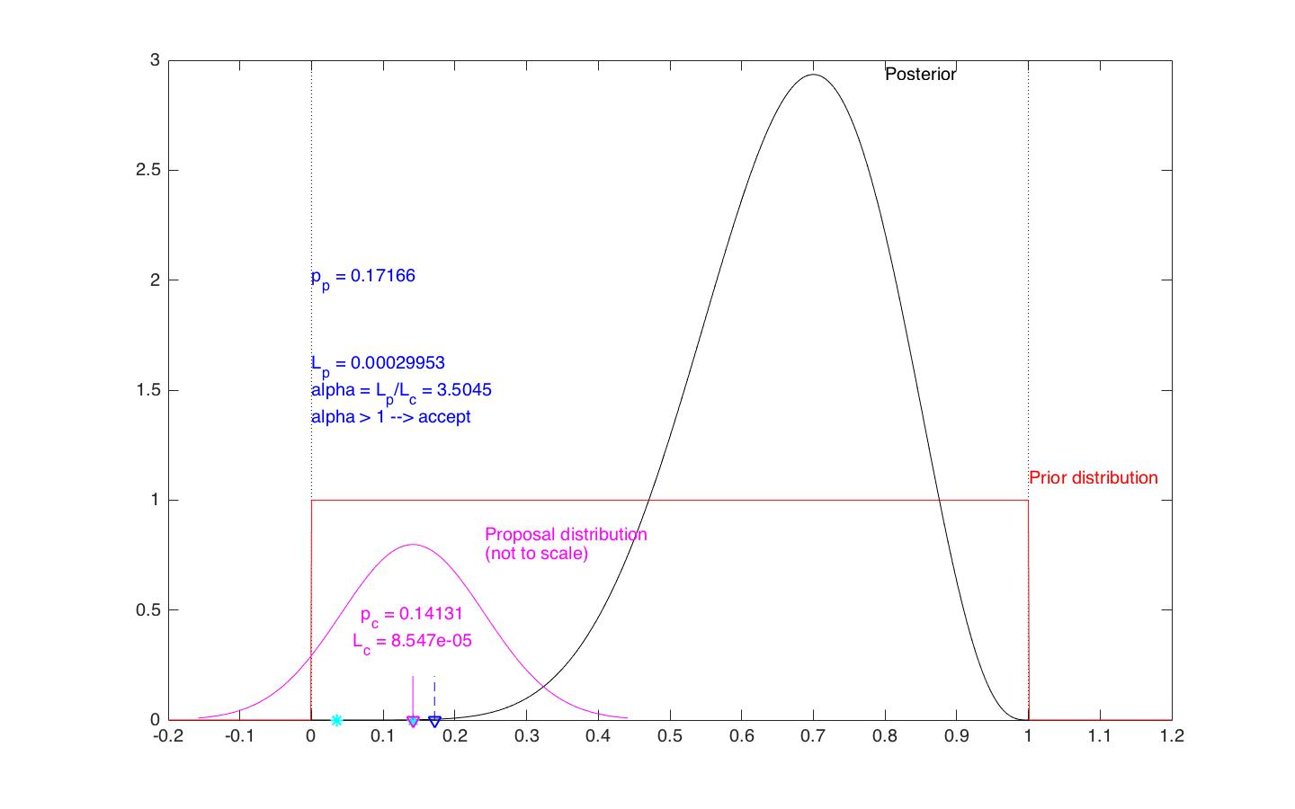

Slide 33
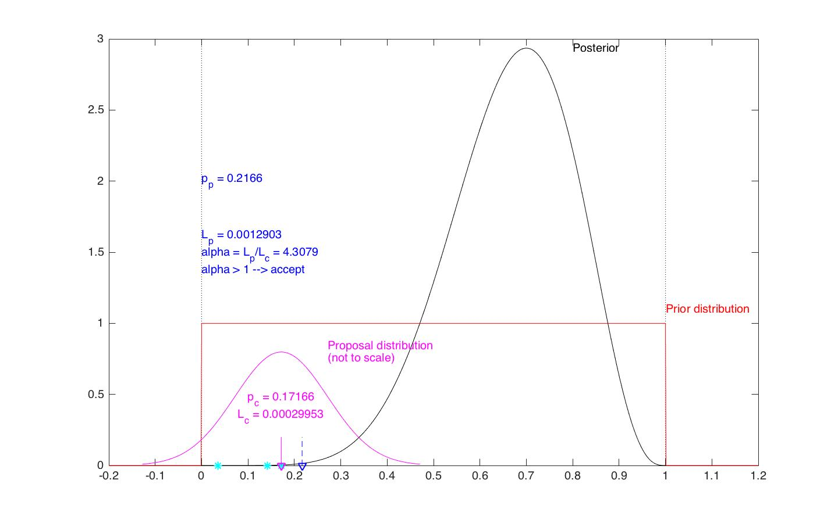

Slide 34
Where to start
First, you need your data – this is given
Second, you need to work out how to compute the likelihood – this comes from the model you have assumed
Then you need to choose (once and for all):
a prior distribution for your parameters
a proposal distribution
a starting value for the parameters (it should have no influence on the final result)
Finally you need to choose (and play around with):
the length of your chain
width of proposal distribution
thinning and burn-in

Slide 35
MCMC for coin tosses
Rules of the game: coin tosses
Data:
number of heads
Goal: explore the posterior distribution for the probability of the coin giving heads, given the data you have seen. This includes information from:
the prior distribution on (my belief / expert opinion)
the data
Likelihood (which contains the data)
Prior
Posterior
Good news:
this you can ignore!

Slide 36
The likelihood
Our model assumes that the number of heads is binomially distributed. Implicitly, that means:
all tosses are independent of each other
output can only be head or tail (and nothing else)
head occurs with the same probability each time
I have tossed the coin times and I have seen head times:

Slide 37
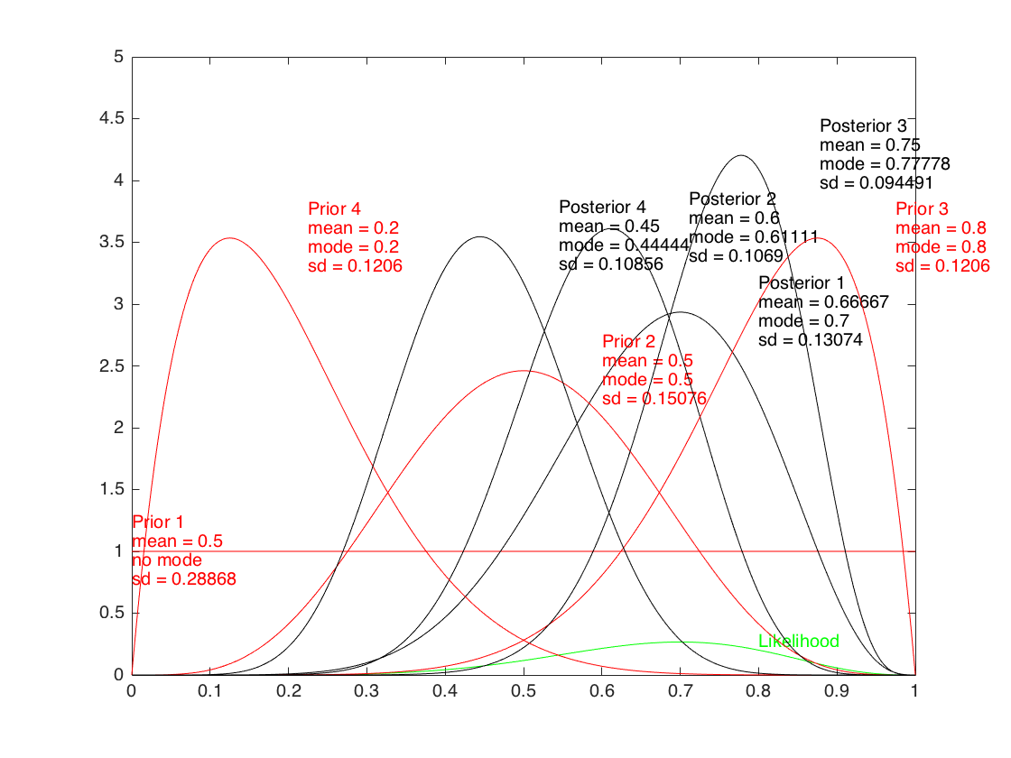
Prior distribution
The prior reflects your knowledge (or expert opinion), e.g.
if you believe the coin is likely to be fair (maybe because you have seen many fair coins and very few non-fair ones), you will choose a prior highly peaked around
if you know nothing at all and don’t trust anybody, or if you want all the information to come from your data, choose a flat one
The choice of the prior matters:
Simplest choice: flat
The difference between your prior and your posterior tells you how much you learnt from the data

Slide 38
Common prior distributions
On (e.g. for probabilities):
uniform, i.e. flat (the pdf is constant = 1 in and 0 outside)
Beta distribution
On (e.g. variances, infection rate, recovery rate…):
flat – this is an improper prior (the pdf is constant “= 0”)
exponential distribution
lognormal distribution
On (e.g. mean of normal distribution)
flat – again, improper (the pdf is constant “=0”)
Normal
The parameters describing your prior are called hyper-parameters

Slide 39
Proposal distribution
In theory, it doesn’t matter which one you choose
In practice, you want one that guarantees your chain “mixes well”, i.e.
you move around (instead of staying for long on the same place)
you explore your parameter space quickly
Unless you know what you are doing (e.g. Gibbs sampling), choose a Normal distribution:
with mean the previous value of your parameter
with a standard deviation you will tune by trial and error
The Normal is convenient because it’s symmetric (see below)
In more than 1 dimension, use a multivariate Normal (you can play with the covariance matrix)

Slide 40
Acceptance probability
This is the clever bit that allows the miracle to work
At each step you have:
An old (current) parameter and a new (proposed) one
The likelihood and the prior computed in both and
The probability of your proposal distribution making you jump:
from to :
and backwards:
Then you compute:
and you accept with probability
Posterior
Prior

Slide 41
Simpler acceptance probability
When computing
If the prior is constant in the allowed range, it cancels out
If you fall outside the allowed range of the prior , i.e. and you reject for sure
If is symmetric, the probability of jumping in one direction or backwards are identical, and also cancels out
This is why the Normal distribution is a good choice
If the likelihood has some common factors independent of , they cancel out (e.g. the binomial coefficient)

Slide 42
Starting value for parameters
When running MCMC, you have to wait until your chain has “converged”, i.e. has run long enough that:
you have forgotten your initial conditions
you are bouncing around the stationary distribution (which is exactly your posterior by construction!)
Therefore, it doesn’t matter where you start from – choose what you prefer!
Further, it might be useful to choose different starting values to ensure that each run still converges to the same stationary distribution (as it should)

Slide 43
Length of chain
You should run your chain long enough
You want 1,000-10,000 (almost) independent samples (nice histogram)
Rule of thumb:
run your chain for 1,000 steps
look at the autocorrelation plot
check after how many steps the correlation becomes small (i.e. between the horizontal lines in the plot), say 50
you want to run your chain 50 x how many (almost) independent samples
If the chain is too big to save on your computer you can “thin” it by a factor , i.e. save one output every

Slide 44
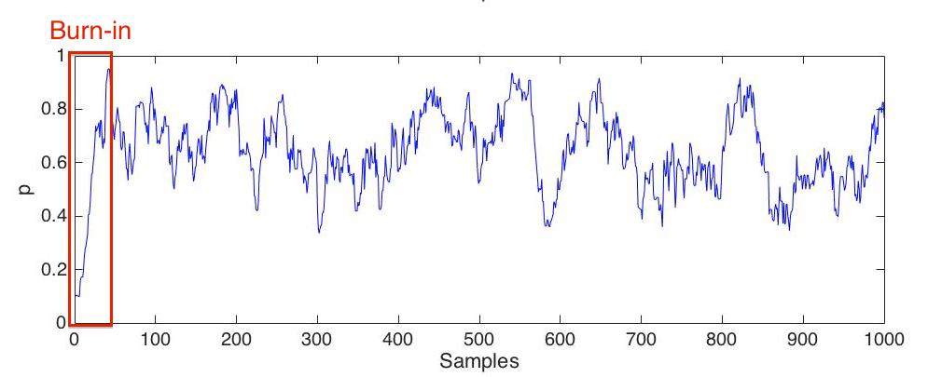
Burn-in
You only want a sample from the stationary distribution (= the posterior)
The burn-in is the initial part of the chain, that depends of where you started from, and that looks “different” from the rest of the chain, because you haven’t yet converged
The burn-in should be identified by eye from the trace plot and discarded

Slide 45
Width of the proposal
If your proposal is very wide, you want to jump very far, usually out of the range of the prior or into regions of low posterior probability:
high rejection rates
chain visibly constant in bits
Choose a smaller standard deviation
If your proposal is very narrow, your proposals are almost always accepted, but you move very slowly around the parameter space:
high acceptance rates
chain with visible broad oscillations
Choose a larger standard deviation
Both the problems above lead to large autocorrelation (bad)
In 1 dim, acceptance rates should be between 20 and 60%

Slide 46
MCMC in practice
MCMC for coin tossing (1 dim)
Diagnosing your MCMC
Tricks
MCMC in 2 dim

Slide 47
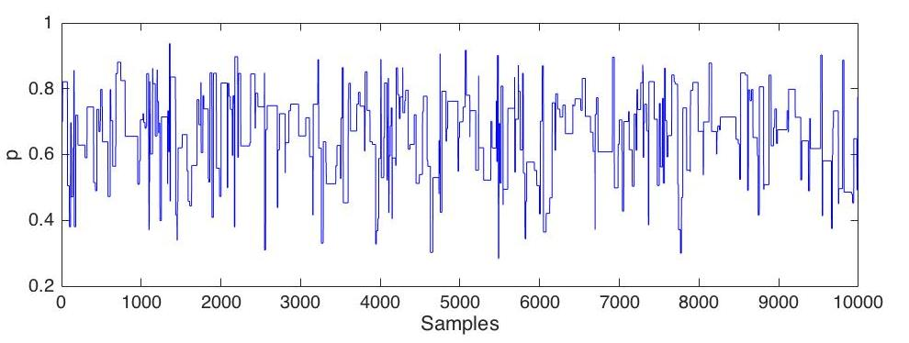
Diagnostics (1 dim)
Proposal too wide: reduce standard deviation

Slide 48
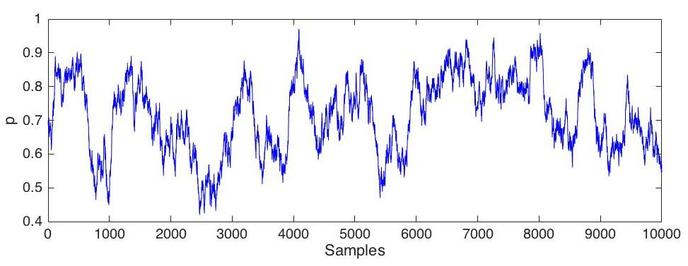
Diagnostics (1 dim)
Proposal too narrow: increase standard deviation

Slide 49
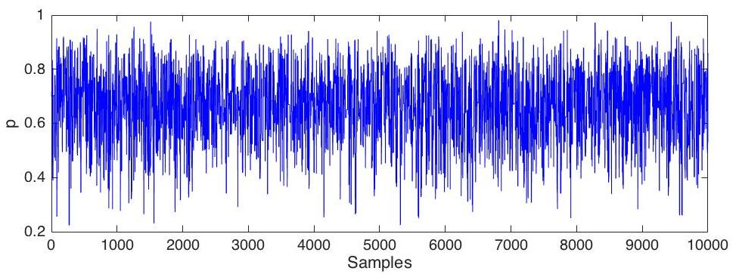
Diagnostics (1 dim)
Good mixing!
To be sure, you should zoom into a section towards the beginning and a section towards the end and they should look similar!

Slide 50
MCMC in practice
MCMC for coin tossing (1 dim)
Diagnosing your MCMC
Tricks
MCMC in 2 dim

Slide 51
Trick 1: log-likelihood
Instead of using the likelihood, use the log-likelihood
This should always be done:
it has no drawbacks
reduce numerical error (likelihood can have really small values)
cheaper computations (products become sums, exponentials become products)
E.g. binomial likelihood
Ignore constant factors independent of (they cancel out in )
Take the log
At this point, it is convenient to work with and to use the log for all its factors (proposal and prior)

Slide 52
Trick 2: avoid useless calculations
Calculating the likelihood is usually very expensive
If you propose a new parameter where the prior is 0 (e.g. outside ), reject immediately, before calculating
Cheaper to test an “if” statement than to generate random numbers:
If , accept without generating a random number to choose whether to accept or reject

Slide 53
Trick 3: Always plot the prior
If your posterior is different, it tells you how much you have learnt from the data
If your posterior is very similar, it means the data contains very little or no information about that parameters (unidentifiability issue)

Slide 54
MCMC in practice
MCMC for coin tossing (1 dim)
Diagnosing your MCMC
Tricks
MCMC in 2 dim

Slide 55
Proposal in 2 dimension
You can choose whether to:
propose 1 at a time (e.g. from a simple Normal distribution in 1 dim), while keeping the other fixed:
OK if parameters are relatively uncorrelated
Bad if they are strongly correlated
Very good if you can specify analytically the conditional posterior (Gibbs sampling)
or propose both parameters in one go (e.g. from a multivariate normal) – this is called block update
A good solution when the parameters are strongly correlated

Slide 56
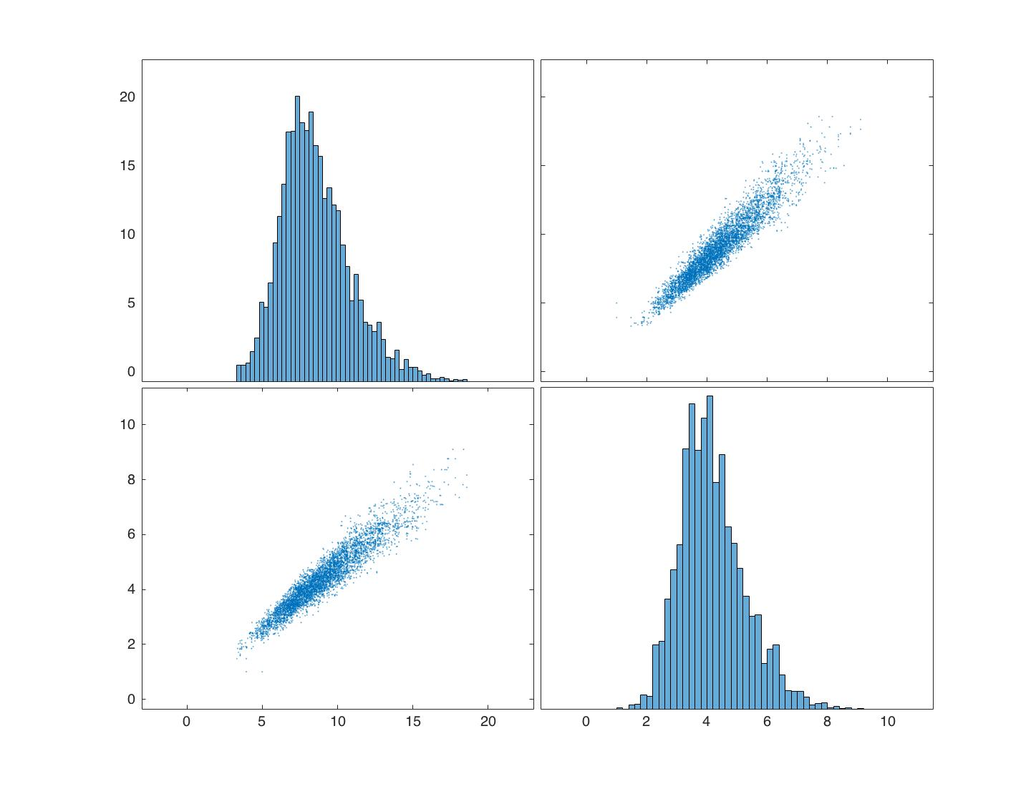
Plotmatrix
Plotmatrix is a command (in Matlab) that creates a fancy plot that can reveal correlation between parameters

Slide 57
Strongly correlated parameters
Tricks to improve mixing:
Block updates, possibly from a multivariate normal “elongated” in the direction of the correlation
Re-parameterise your model with new parameters that are less correlated.

Slide 58
PLAY with Matlab or R

Slide 59
Strongly correlated parameters
“MCMCBinomial” file: play with
n_tosses
n_heads
n_iters
thinning
sd_proposal (try 0.01 or 5)
burnin
“MCMCEpidemicFinalSizeLargePop” file: play also with
Updating in block or not
Tuning the sd_proposal for either parameter

